Slide 1
eGarage Mobile Application
JORGE ROBLA

Slide 2
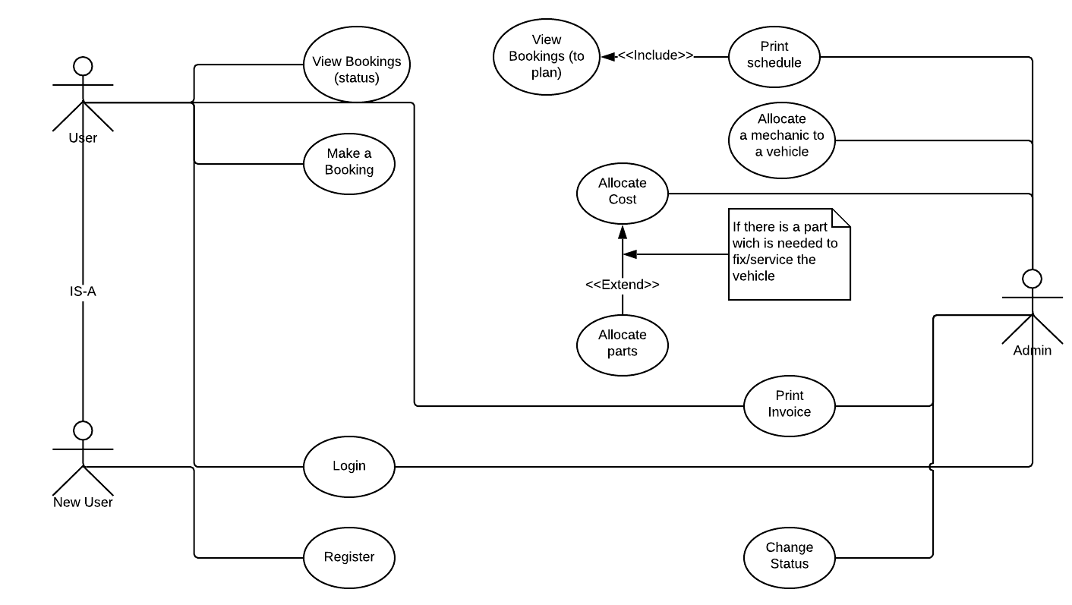
eGarage: Mobile app to register and automate activities, performed for Ger’s garage by customers, mechanics and the garage owner (CCT Brief)
Technologies used:
1. Android Studio 3.5.3 (IDE)
2. Software Development Kit (Api Level 28) – Android 9 (Pie)
3. Java Programming Language version 8
4. Cloud Firestore database (27.3.1) and Firebase Authentication (19.2.0)

Slide 3
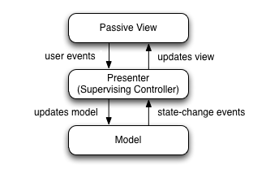
Stages of Software Development Process
Research about Databases and Android Framework
Analysis and Design: I used diagrams (UML) and www.lucidChart.com
Use case diagram and use case descriptions, Domain Model, Sequence diagram, State Machine diagram, Wireframe design, Class diagram, Design the structure of the database for a No-SQL database
Installation and customization of the tools and systems
Coding and testing
Creation of the database in FireStore
Architectural Pattern Design MVP (Model – View
- Presenter). 1 View – 1 Presenter:
LoginView - LoginPresenter
RegisterView – RegisterPresenter
HomeUserView – HomeUserPresenter
……
Creation cache in Android to pass info among screens
Testing: Screens and functionalities. Integration testing

Slide 4
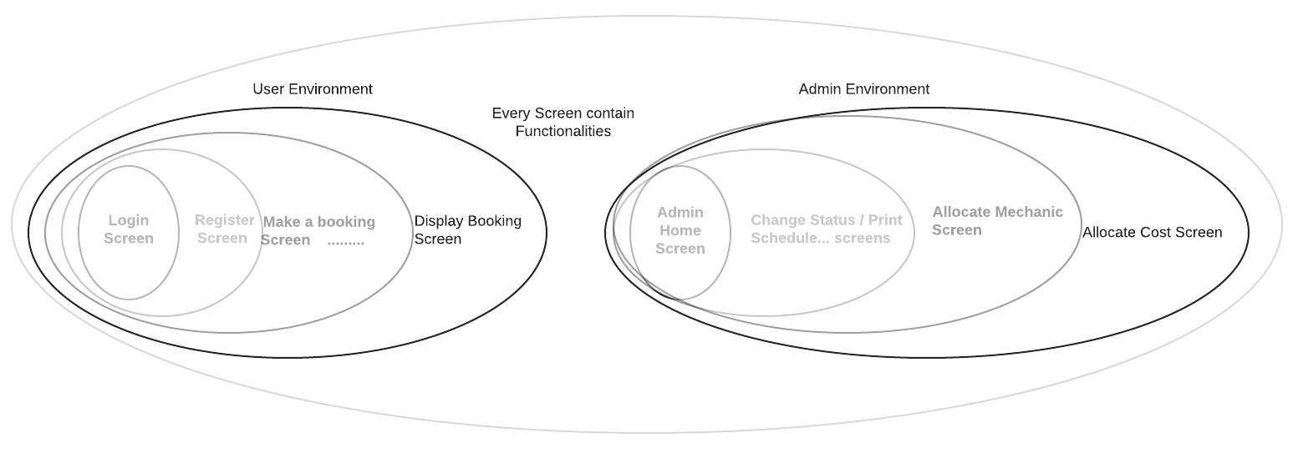
MVP Driven Development and Testing

Slide 5
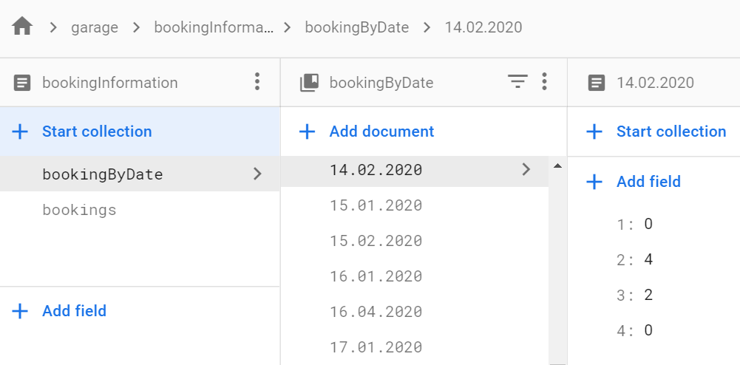
Booking Structure
How does booking work for a day?
Shift 1 (8am) (Mechanics are all different in each shift)
Slot 1 – Mechanic 1
Slot 2 – Mechanic 3
Slot 3 - Mechanic 2
Slot 4 – Mechanic 4
Shift 2 (10am)
Slot 1 – Mechanic 4
Slot 2 – Mechanic 2
Slot 3 - Mechanic 1
Slot 4 – Mechanic 4
Shift 3 (1pm)
…….
Shift 4 (3pm)
…….
Database
Mayor repair 2 shifts

Slide 6
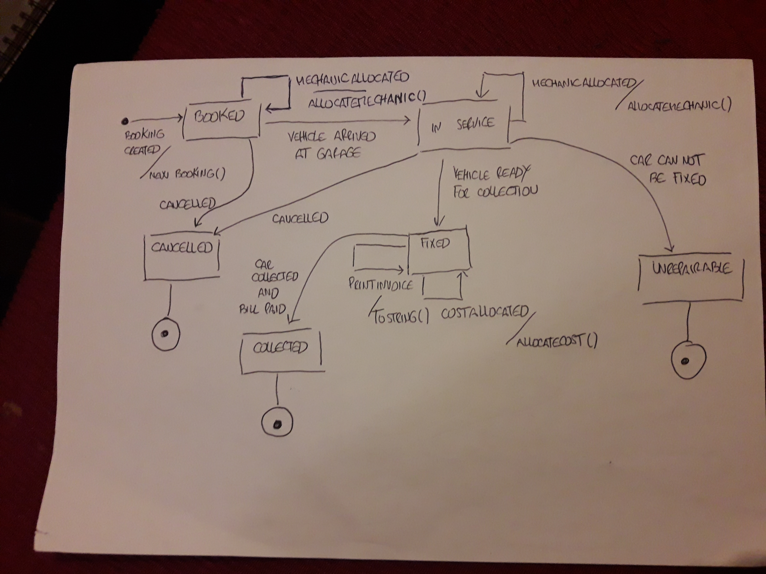
State Machine Diagram

